Slide 1
Back Tracking

Slide 2
Back tracking can be described as an organized exhaustive search which
often avoids searching all possibilities.
This technique is generally suitable for solving problems where a potentially large, but finite number of solutions have to be inspected.

Slide 3
Here the desired solution is expressed as an n- tuple (x₁,x₂,x₃…x_{n}) where the x_{i}‘s are chosen from some finite S_{i}.
If m_{i} is the size of set S_{i}. Then there are m = m₁m₂…m_{n} n tuples that are possible candidates.

Slide 4
The back tracking algorithm has its virtue the ability to yield the same answer with far fewer than m trials.
Its basic idea is to build up the solution vector one component at a time and
to use some criterion function P_{i}(x₁,x₂,…x_{i}) to test whether the vector being formed has any chance of success.

Slide 5
If it is realized that partial vector so formed (x_{1,} x₂…x_{i}) can in no way lead to an optimal solution,
then m_{i+1}m_{i+2}….m_{n}
possible test vectors can be ignored entirely.

Slide 6
Some terms used in back tracking approach
Explicit Constraints: these are rules that restrict each x_{i} to take values
only from a given set.
e.g. X_{i} >= 0
x_{i}=0 or 1
Implicit constraints: These are rules which describes the way in which the x_{i} ‘s must relate to each other.

Slide 7
Solution space: it is the set of all tuples that satisfy the explicit constraints.
State space tree: The solution space is organized as a tree called state space tree.
Live node: A node which has been generated and all of whose children have not been generated so far is called a live node.
Dead node: it is a generated node which is not to be expanded further
Or
all of whose children have been generated

Slide 8
E- node: the live node whose children are currently being generated is called E-node.
Bounding function: is a function created which is used to kill live nodes without generating all its children.

Slide 9
The Bicycle problem
Consider a combination lock for a bicycle that consists of a set of N switches each of which can be ‘on’ or ‘off’.
Exactly one setting of all the switches with [N/2] or more in the ‘on’ position, will open the lock.
Suppose we have forgotten this combination and must get the lock open.
Suppose also that you are willing to try (if necessary) all combinations.

Slide 10
We need an algorithm for systematically
generating these combinations.

Slide 11
If we ignore the n/2 condition(given clue), there are 2^{n} possible combinations for the lock.
We model each possible combination with an n- tuple of 0’s and 1’s.
1 for the switch on
0 for switch off.
Using A (0-1) vector of size 4
We can represent all combinations

Slide 12
root
1
0
11
01
00
000
111
110
101
100
011
010
001
1111
1110 1101 1100 1011 1100 1001 1000
0111 0110 0101 0100 0011 0010 0001 0000

Slide 13
1 →11 →111 →1111(check) →111(backtr)
→1110(check) →111(backtr) →11(backtr) →110→1101(check) →110(backtr) →1100 →110(backtr) →11(backtr) →1(backtr.)→10 →101 →1011(check) →101(back tr.) →1010(check) →101 (back tr.) →10(back tr.) →100 →1001(check) →100 (back tr.) →10(back tr.) →1 (back tr.) →root →0….

Slide 14
Using this binary tree we can now state a back track procedure for generating only those combinations with atleast [n/2] switches on.
This algorithm amounts to traversal of the tree.
Move down the tree as far as possible to the left until we can move no further.
Upon reaching an end vertex, try the corresponding combination.
If it fails, back track up one level and see if we can move down again along an unsearched branch.
If it is possible take the leftmost unused branch.
If not back track up one more level and try to move down from this vertex.
Before moving down check if it is possible to satisfy the [n/2] restriction at any successor vertex

Slide 15
Algorithm terminates when we return to the root and there are no unused branches remaining.

Slide 16
8 – Queen Problem
To place eight queens on an 8 by 8 chess board so that no two queens“ attack” i.e. no two queens are on the same row, column ,or diagonal.
To solve it by back tracking approach we must see the solution as an n- tuple (x₁,….x_{n}) where each x_{i} should come from a finite set.

Slide 17
There are many ways to represent the positions of these queens on the board.
Select a suitable one.
1- represent the position of a queen by row and column no of the cell:(queen no,row no,column no)
no the cells as 1 to 64 then write the position of a queen(queen no,cell no)
Assume first queen in first row ,second queen in second row and so on

Slide 18
Let us number the queens 1 to 8.
Also number rows and columns from 1 to 8.
Since each queen has to be in different row
we can assume that queen 1 moves in row 1 queen 2 moves in row 2 and so on.
Using this convention,
Any non attacking placement of queens can be represented as (c₁ , c_{2,}, c₃……c₈)
C_{i} represents the column number in which queen i is placed.

Slide 19
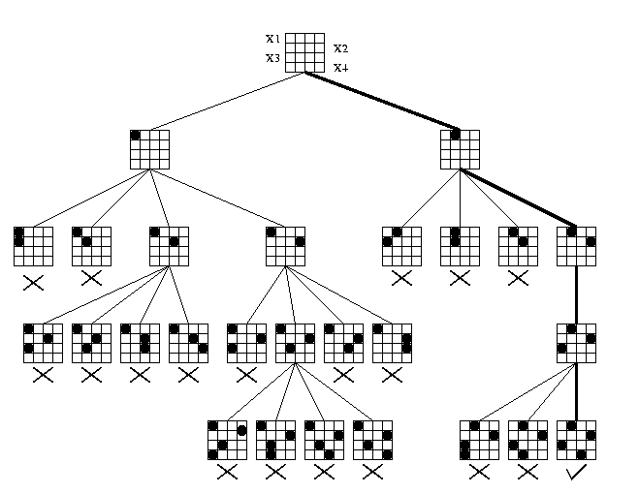
4 queen problem

Slide 20
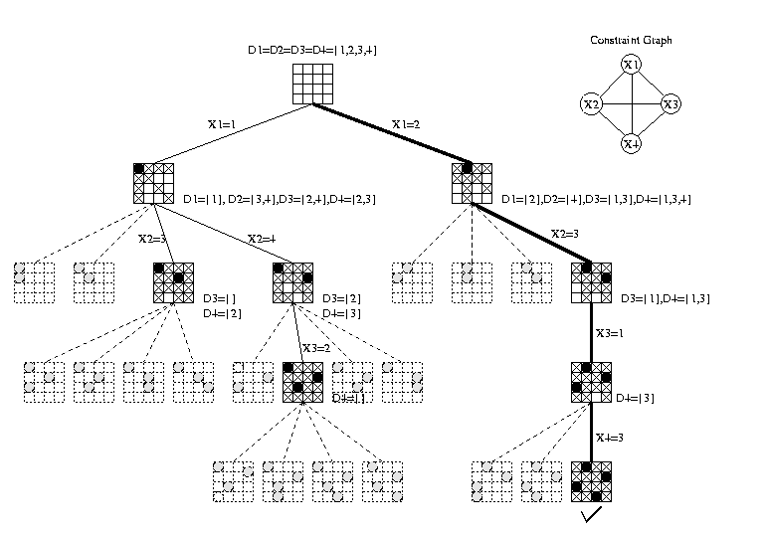

Slide 21
1
1
1
 |  | 2
1
 |  |  | 2
 | 3
1
 |  |  | 2
 | 3
 | 1
 |  |  | 2
 | 1
 |  |  | 2
3
 |  | 4

Slide 22
STATE Space tree
1
X₁=1
X₁=2
2
3
X₂=4
X₂=2
X₂=4
X₂=3
B
X₃=1
X₃=3
B
B
X₃=4
X₃ =2
X₃=2
X₄=3
B
B B
X₄=3
B

Slide 23
Sum of subsets problem
Suppose we are given n distinct positive numbers and a number m
we desire to find all combinations of these known numbers whose sums are exactly m.
Given a set of n distinct numbers we need to find all subsets of it having sum of its elements exactly equal to the given number m.
.

Slide 24
Case Study 2: Sum of Subsets (cont.)
The following incarnation SuM of the general backtracking algorithm
has two additional formal parameters:
• s for the sum of elements that has been selected,
• r for the overall sum of the remaining stock.
Algorithm Backtracking(k)
{ for each child x[k] of x[k-1] in T do
if x[1..k] does not meet the boundary B
then {if x[1..k] is a path to a leaf of T
then { if the leaf meets the implicit constraint C
then output the leaf and the path x[1..k]
}
else Backtracking(k+1)
}
}
Algorithm SuM(k, s, r)
{ x[k]:=1 ;
if (s<=M) & (r>=M-s) & (w[k]<=M-s)
then { if M = s +w[k]
then output all iÎ[1..k] that x[i]=1
else SuM(k+1, s+w[k], r -w[k])
} ;
x[k]:=0 ;
if (s<=M) & (r>=M-s) & (w[k]<=M-s)
then { if M = s
then output all iÎ[1..k] that x[i]=1
else SuM(k+1, s, r -w[k])
}
}

Slide 25
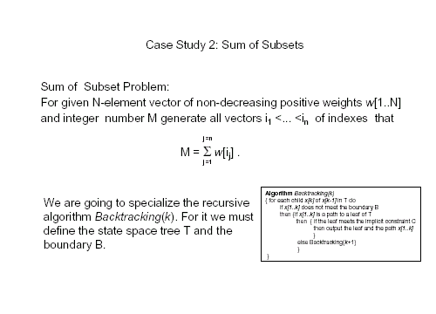

Slide 26

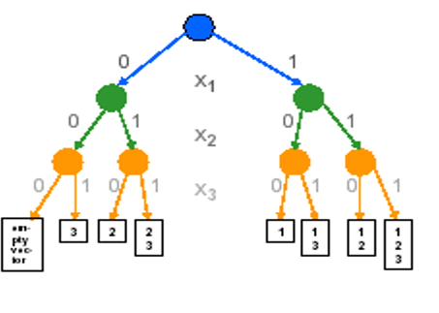
State Space Tree

Slide 27
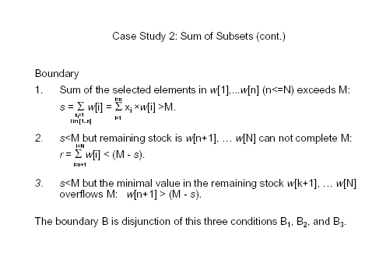

Slide 28
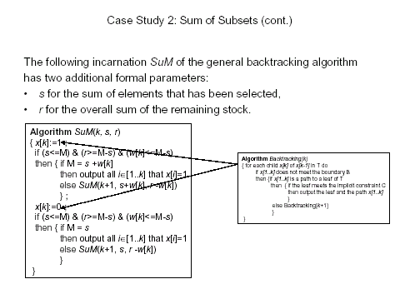

Slide 29
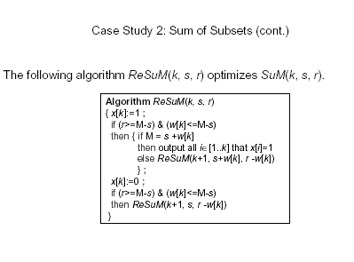

Slide 30
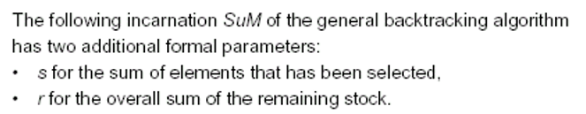
Example
W[1..6] ={5, 10, 12, 13, 15, 18}
M=30

Slide 31
First of all we sort the given elements
W[1..6] ={5, 10, 12, 13, 15, 18}
M=30
0,1,73
[s,k,r:] decision for the kth element
X₁=1
5,2,68
0,2,68
X₂=1
X₂=0
10,3,58
0,3,58
15,3,58
5,3,58
0,3,58
X₃=0
X₃=1
X₃=1
X₃=0
10,4,46
27,4,46
15,4,46
17,4,46
5,4,46
X₄=1
X₄=0
B
5,5,33
10,5,33
28,5,33
15,5,33
X₅=1
20,6,18
X₅=1
A
An answer of the given problem

Slide 32
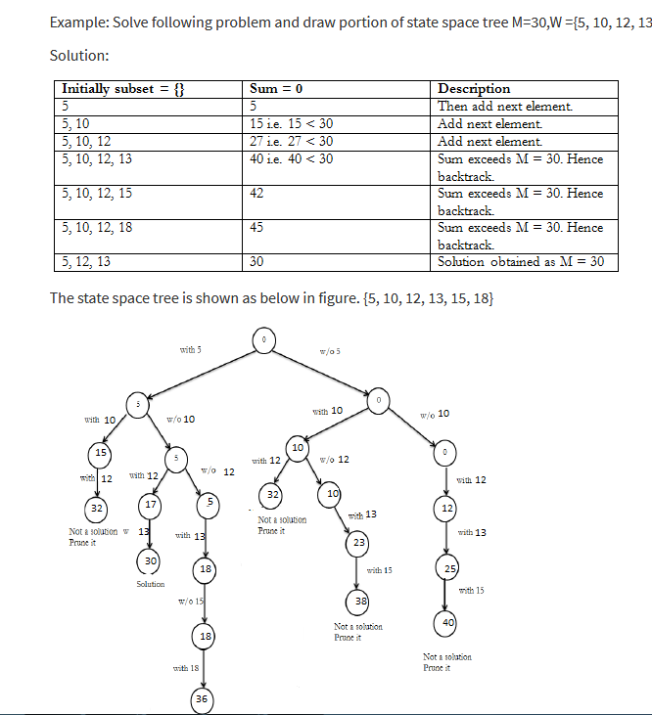
W = (5,12,13,10,18,15)

Slide 33
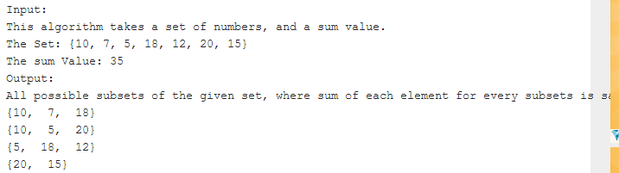

Slide 34
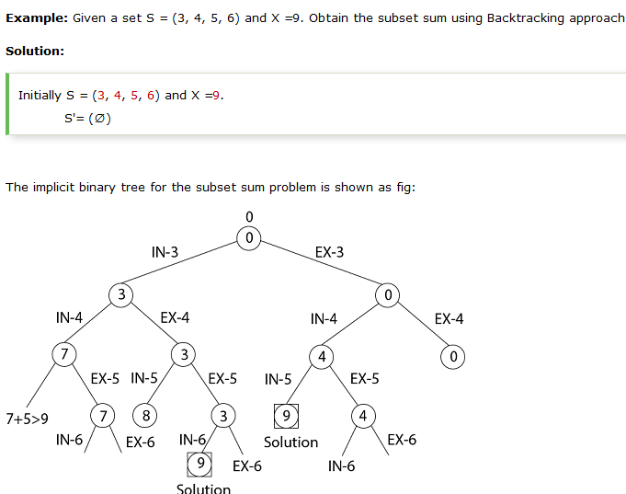

Slide 35
0-1 Knapack Problem
Given n positive weights w_{i}, n positive profits p_{i} and a positive number M which is the knapsack capacity
The problem calls for choosing a subset of the weights such that
∑w_{i} x_{i} ≤ M
1 ≤ i ≤ n
and
∑ p_{i} x_{i} is maximized
1 ≤ i ≤n
X _{I} =0,1

Slide 36
Two possible tree organization is possible.
One corresponds to the fixed tuple size formulation and the other to the variable tuple size formulation.
A good bounding function for this problem is obtained by using an upper bound on the value of the best feasible solution obtained by expanding the given live node and any of its descendants.
If this upper bound is not higher than the value of the best solution determined so far then this live node may be killed.

Slide 37
Using fixed tuple size formulation:
If at a node Z the values of x_{i} , 1 ≤ I ≤ k have already been determined, then an upper bound for Z can be obtained by relaxing the requirement
x_{i}=0 or 1
to 0 ≤ x_{i} ≤ 1 for k+1 ≤ i ≤ n
And it can be solved by simple greedy method

Slide 38
Example: P=(11,21,31,33,43,53,55,65)
W= (1,11,21,23,33,43,45,55)
M = 110
N= 8
Relaxing 0,1 condition and using greedy approach
solution is (1,1,1,1,1,21/43, 0, 0)
Having 164.88 profit.
This value will work as an upper bound for the required solution.

Slide 39
Static state space tree
(1,1,1,1,1,21/43, 0, 0)
For all yellow colored nodes upper bound is same as of root ode i.e. 164.88
164.88
1
0
1,11
155.11
Weight,
profit
1
0
1
12,32
154.7
0
157.44
0,1,1,1,1,22/43,0,0,0
1
33,63
1
0
56,96
E
bound
1
160.22
0
1
159.76
89,139
66,106
157.55
0
164.66
162.44
99,149
109,159
F
0
161.63
159.79
163.81
162
101,1 51
160.18
0
P=(11,21,31,33,43,53,55,65) W= (1,11,21,23,33,43,45,55)
M = 110
139
A
B
C
D
149
151
159
(1,1,1,0,1,1,0,0)

Slide 40
(1,1,1,1,1,21/43, 0, 0)
Root represents a sol of relaxed knapsack problem,
here x6 is fractional
1
164.88
X₆=0
X₆=1
2
163.3
X₇=0
164.66
X₅=0
X₅=1
3
X₈=0
4
159.56
5
X₄=1
139
6
156.66
11
159.52
X₅=0
7
8
x₃=0
12
P=(11,21,31,33,43,53,55,65)
W= (1,11,21,23,33,43,45,55)
M = 110
128
X₃=0
9
10
140
150
Dynamic state space tree for knapsack problem

Slide 41
This is lower bound

